Slide 1
Excel Charts

Slide 2
Definition of Spreadsheet
A program that allows you to use data to forecast, manage, predict, and present information

Slide 3
Using data from the Great Backyard Bird Count, the following spreadsheet was created to show the 3 birds most often spotted in Iowa for the years 1998, 2000, 2002 ,2004, 2006, 2008, 2010, and 2012.

Slide 4
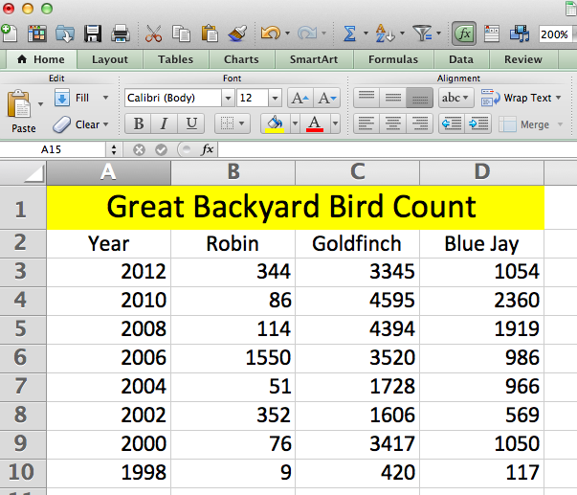
This is the spreadsheet worksheet.
What bird was counted the most often?
Why is it hard to answer this question?

Slide 5
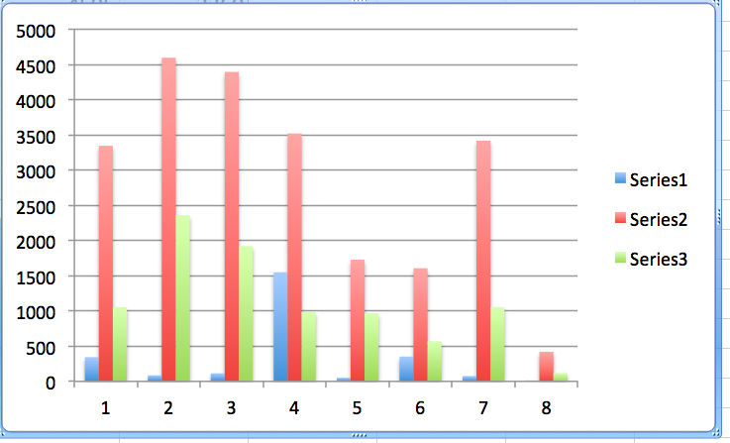
Is it easier to tell in chart format? Is anything still missing?

Slide 6
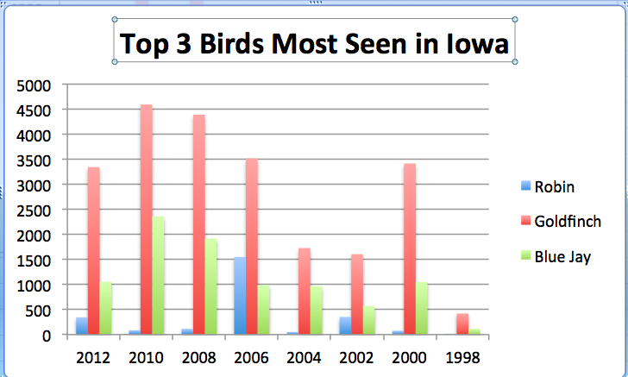

Slide 7
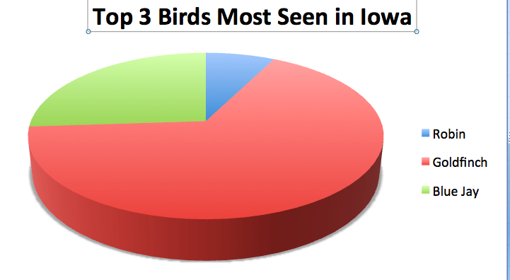
Is this easier still to read?

Slide 9
Where and When Birds Travel Global climate change appears to have an impact on the wintering and breeding ranges for birds throughout North America. The Christmas Bird Count, conducted by the National Audubon Society for the past 100 years, demonstrates that almost 60% of the 305 species that winter in North America have changed their range – shifting to the north an average of 35 miles since the mid 1960’s. A number of species, like the American Robin and the Wild Turkey, have shifted their winter destinations several hundred miles. This change in range, related to climate change, results in habitat and ecosystem disruption.
* http://www1.cyfernet.org/act-CYFAR/mom/02-10-backyardbird/

Slide 10
Discussion and Reflection Questions:
When birds no longer winter in an area, what is the impact of their loss on that ecosystem? On the plants, insects, animals and humans left behind? What roles do birds play in an ecosystem?
When birds winter further north, what impact do they have on that existing ecosystem? Should we consider these birds to be ‘invasive species’?
Will a bird’s food and shelter sources (such as plants and insects) have a similar ability to quickly shift their winter range to provide adequate food and shelter in the new range?
Humans often put out bird feeders and bird houses to help birds survive the winter when food sources can be difficult to find. What are the positive and negative aspects of our ‘helping’ the birds? What would happen if humans stopped providing food and shelter?
While average January temperatures have been increasing, climate change also means increased incidence of “severe winter weather” (such as periods of intense cold, heavy snowfall, strong winds). What might be the impact of severe weather on birds living in their new northern range?

Slide 11
Why Count Birds? Scientists and bird enthusiasts can learn a lot by knowing where the birds are. Bird populations are dynamic; they are constantly in flux. No single scientist or team of scientists could hope to document the complex distribution and movements of so many species in such a short time.
*http://inclusivehomeschool.com/2008/02/13/birds-great-backyard-bird-count/

